Slide 1

Neutral Network: Representation
Examples and intuitions I

Slide 2
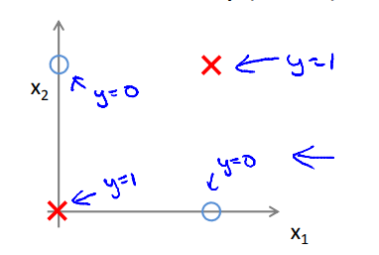
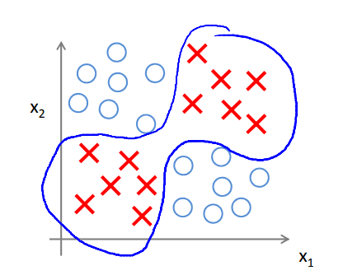
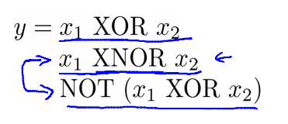
Non- linear classification example: XOR/ XNOR
$x_{1}, x_{2}$ are binary (0 or 1)

Slide 3
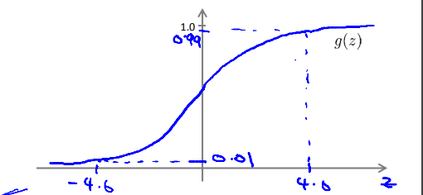
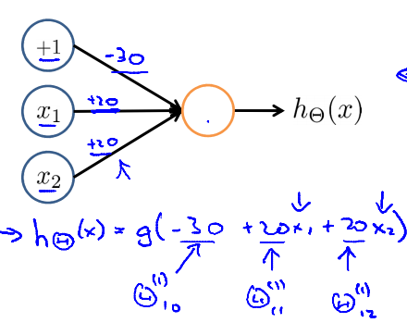
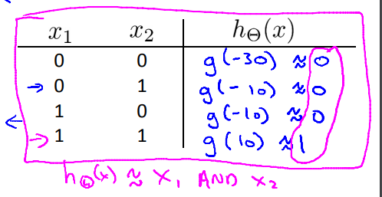
Simple example: AND
$x_{1}, x_{2}$ Є (0 or 1)
y = $x_{1} AND x_{2}$

Slide 4
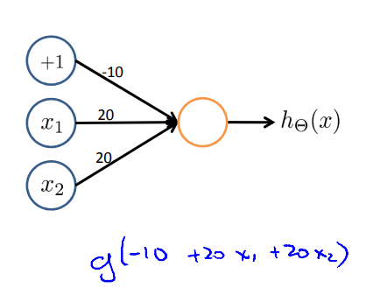
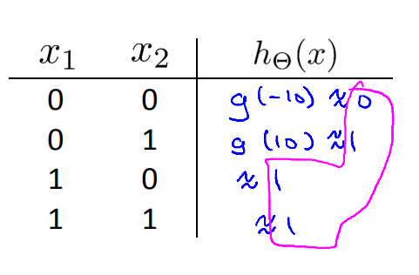
Example: OR

Slide 5
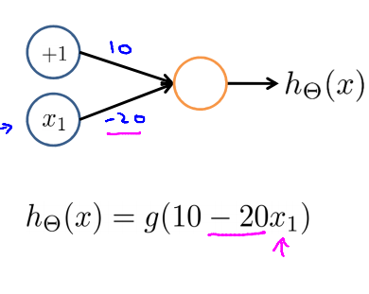
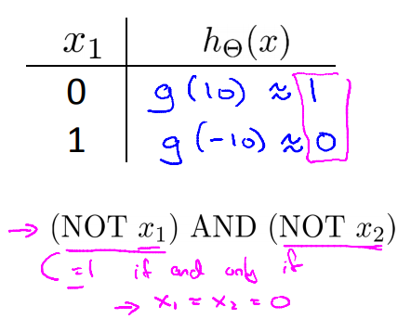
Negation
NOT $x_{1}$

Slide 6
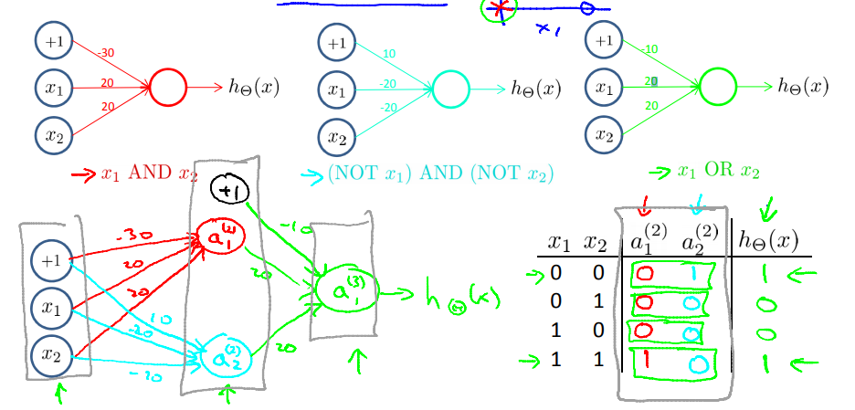
Putting it together
$$x_{1} XNOR x_{2}$$

Slide 7

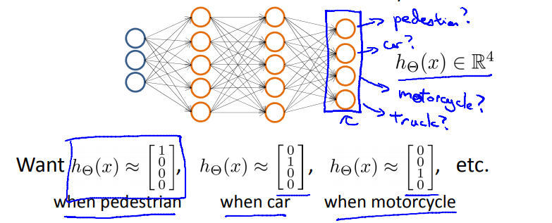
Multi – class classification

Slide 8




